Slide 1
亚历克上 - M202161029
2021 - 2024
Advanced communication coding
-
information and communication department
-
ustb
Lecturer - 杜利平(Liping Du)

Slide 2
OPTIMAL SINGULAR VALUE DECOMPOSITION BASED BIG DATA COMPRESSION APPROACH
Definition of terms?
Why is Data Compression Useful?
Main theme of the research?
Other Methods?
Formulars & Calculations?
Magic Behind?
PROPOSED METHOD?
Findings?
Numerical Results ?
Chart Results?
Comparisons.
Conclusion

Slide 3
Definition Of Terms
Data compression
SVD
Smart grid

Slide 4
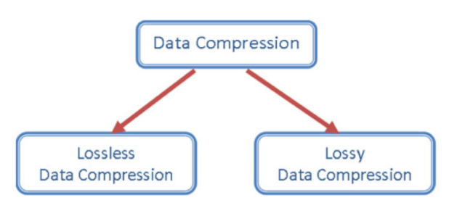
Data Compression - is the process of encoding ,modifying data in order to reduce its size.

Slide 5
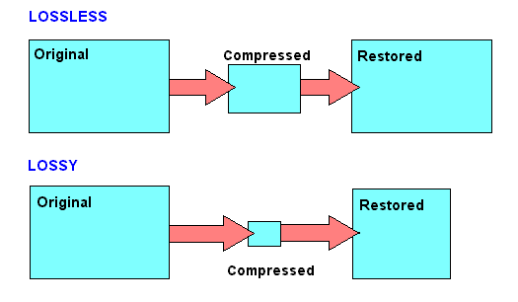
illustration on the differences of lossless and lossy data compression.
Application:
Lossless - Animation , medical compression toolkit’s.
Lossy - audio,pictures.

Slide 6
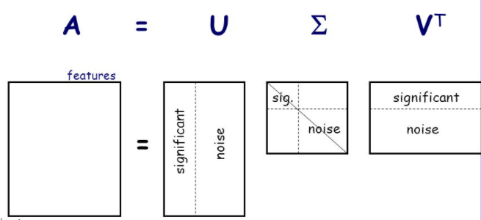
OPTIMISATION SINGULAR VALUE DECOMPOSITION (SVD)
It is a factorization of a real complex matrix.
It is well illustrated by a formular:
A = UΣV T where ; U is an m x n complexy unitary matrix
Σ is an m x n rectangular matrix with non-negative real numbers on the diagonal
V is an n x n complex unitary matrix to the power T

Slide 7

SMART GRIDS
It is an electricity network enabling two-way flow of electricity and data with digital communications technology enabling communication between suppliers and consumers.

Slide 8

SMART GRIDS
It is an electricity network enabling two-way flow of electricity and data with digital communications technology enabling communication between suppliers and consumers.

Slide 9


Slide 10
WHY DATA COMPRESSION USEFUL

Slide 11
MAIN 4 REASONS
STORAGE
Transmission speeds
Reduces the amount of space needed to store data.
amount of sending files over the internet depends on the size of the transmitted file
ARCHIVING AND BACKUP
Digital television
Large group of sequential files can be combinesd into archieve files.
Files are compressed before transmitted.

Slide 12
SVD is applied to a matrix that achieves the optimal number of singular values to the sending process and the other ones will be neglected. This goal is achieved by retrieving the quality and compression ratio.
Very intelligent optimization methods are used to determine the number of optimal values on the elimination stage.
So the optimized rank reduction can pave the way toward a robust and reliable performance.
MAIN THEME
OF THE
RESEARCH
Optimal Singular Value Decomposition Based Big Data Compression Approach in Smart Grids.

Slide 13
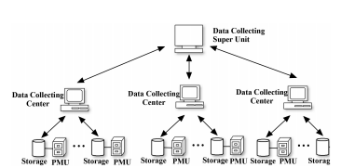
DATA IN SMART GRIDS
Wide Area Monitoring System(WAMS)
Third bullet point here
Phasor Measurement Unit(PMU)
telephone networks
fiber optic cables
low altitude satellites
power line carriers
microwave links

Slide 14
OTHER METHODS
Wavelet Decomposition(WD)
Discrete cosine transform(DCT)
Fuzzy-based methods
Compressed sensing theory
neural Network based methods(NN)
Deep stacked autoencoders
Singular value decomposition(SVD)-based approaches

Slide 15
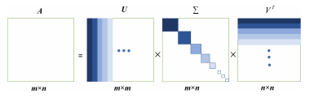

SVD FORM Of A MATRIX

Slide 16
FORMULARS - CALCULATIONS
APPELLATIVE
A - Original data.
¯A - Reconstructed data.
Cr - Compression ratio.
Dr - Elements of remained data.
Dd - Elements of deleted data.
Do - Elements of original data.
GAm - Genetic algorithm with mutation.
m - Rows of the original matrix.
n - Columns of the original matrix.
Nt - Threshold of Euclidean norm for comparison of orig_x0002_inal and retrieved data.
N₂(Z) - Euclidean norm of matrix Z. p Number of deleted singular values.
Sd - Number of deleted singular values.
α - Weight coefficient for Nt

Slide 17

FORMULARS - CALCULATIONS
One of the advantages of SVD is the easier it is to understand when it comes to calculation
Compression ratio is calculated by :

Slide 18

FORMULARS - CALCULATIONS
One of the advantages of SVD is the easier it is to understand when it comes to calculation
Redundancy is calculated by :

Slide 19

FORMULARS - CALCULATIONS
One of the advantages of SVD is the easier it is to understand when it comes to calculations.
Checking the accuracy and proximity between original and retrieved data by Euclidean norm criteria equation :

Slide 20
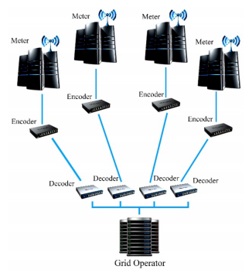
THE MAGIC BEHIND
Data communication channel
transmission process

Slide 21


PROPOSED METHOD
Data exchange between various regions of the smart grid is happening increasingly. The proposed method involves decomposing the original data matrix into U, V, and Σ by the SVD decomposition
Then, the optimal rank reduction is specified and three rank-reduced matrices will be ready to be sent.
Since the main goal of the problem is data compression, the inverse of the compression ratio can be considered as the objective in a minimization problem:
The objective function can be replaced by minus, as shown in the equation: F(x) = −x. By minimizing , the compression ratio will be maximized. More compression ratio can be gained by maximizing the number of neglected singular values.
As a result, the compression is valuable if the information can be retrieved with acceptable accuracy. The fitness function can be calculated by the following equation where K is the coeffient:

Slide 22


PROPOSED METHOD
x can change between the lower bound and upper bound based on the communication network bottlenecks that play a role in determining the compression ratio.
Illustrated by this equation:
The number of singular values ignored is the decision variable. The lower bound expression can be modified depending on the communications network requirements, as shown in the followingequations:

Slide 23
FINDINGS
Numerical Results
Flow Charts
Comparisons

Slide 24
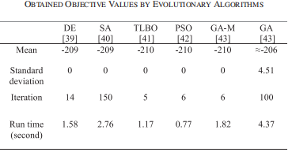
NUMERICAL RESULTS
After running couple of experiments the results were recorded as follows:
DE - Differential Evolution
SA - Simulated Annealing
TLBO - Teaching Learning Based Optimazation
PSO - Particle Swarm Optimization
GA-M - GA with Mutation

Slide 25
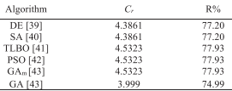
NUMERICAL RESULTS
Using the data above we can now calculate the Compression Ration and the Percentage of Redundant data.

Slide 26
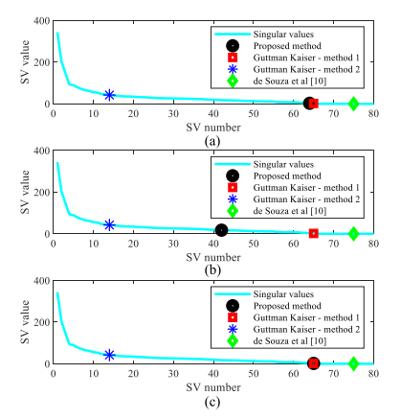
CHART RESULTS
The rank reduction methods with upper bound of error to a-0.005,b-0.05,c-0.0001 of Euclidean norm of the original data :
Test with α = 5%
Test with α = 0.01%
It revealed a good performance.

Slide 27
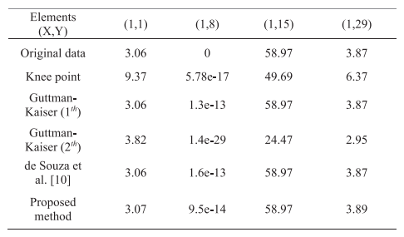
COMPARISONS
Comparison of rank reduction methods on arbitrary elements of original data:

Slide 28
CONCLUSION
an optimization method that finds the optimum point regarding the accuracy constraint is required in data compression, especially for the applications that are sensitive to the error like energy market or smart grid data.
To sum up, the presented method can individually solve the issues appearing by the big volume of data such as required band width and data storage by reducing the number of data elements.
The proposed framework achieves the higher compression ratio as well as the satisfaction of accuracy constraint simultaneously and the redundant section is cut down.
It is simple and efficient and could be utilized by market operators , load aggregators , electricity retailers , and Combined Heat and Power and microgrid operation.

Slide 29
亚历克上 - M202161029
THANK YOU !!!
CLASS OF THREE
PROFESSOr - 杜利平(Liping Du)

